Slide 1

Chapter 1
Winter Sport Tourism: An Overview
Simon Hudson

Slide 2
Topics Covered
An introduction to winter sport tourism
The evolution of winter sport tourism
Winter sport tourism today

Slide 3
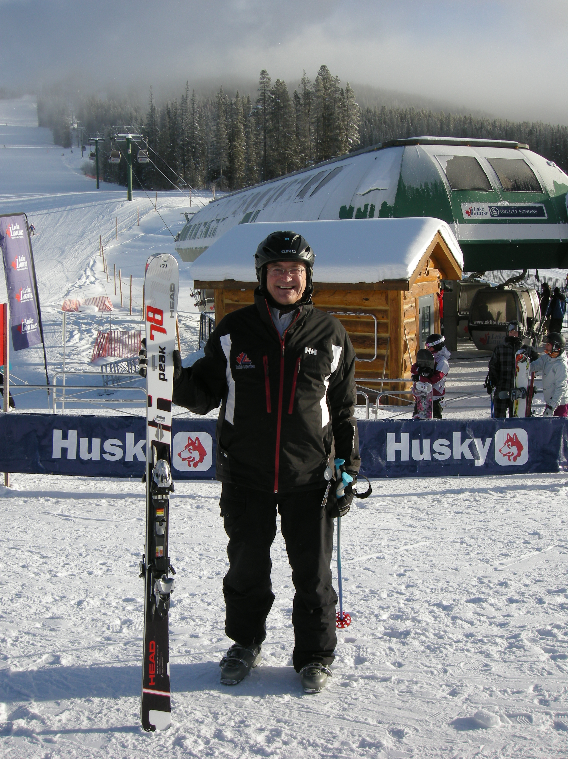
Spotlight
Charlie Locke: Multi-tasking ski entrepreneur
First-class resort: Lake Louise
  family-run by Charlie Locke
Multi-tasking background
  Innovations (volunteer ski guides; discount cards, daycare)
complementary activities
  expanded restaurants and bar facilities
  ski lodge facilities

Slide 4
An introduction to winter sport tourism
Tourism sport VS. Sport tourism
  Hard definition
  Soft definition

Slide 5
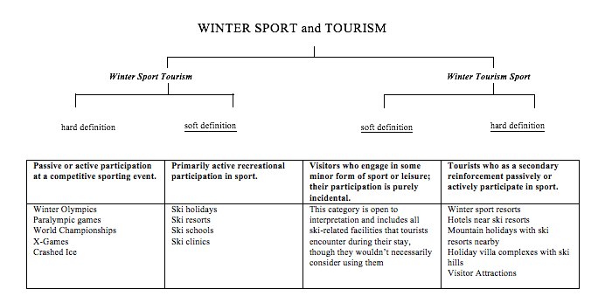
Application of the sport tourism and tourism sport framework to winter sport tourism
Source: Adapted from Robinson & Gammon, p. 229

Slide 6
The business of winter sport tourism
Economic Impacts
Marketing
Mountain Destinations
Ski Resorts
Tour Operators & Intermediaries
Planning & Development
Social Impacts
Transportation
Food & Beverage
The Winter Sport Tourist
Equipment &
Clothing
Accommodation
Entertainment
Ski Events
Ski
Media
Ski Attractions
Real Estate
Ski Schools
Ski touring
Financing
Employment
Environmental Impacts

Slide 7
The evolution of winter sport tourism
Started after 1866, Switzerland
Second World War: ski emerge in a mass tourism
1960s: ski boom
1990s: snowboarding boom
2000s: diversification in the industry

Slide 8
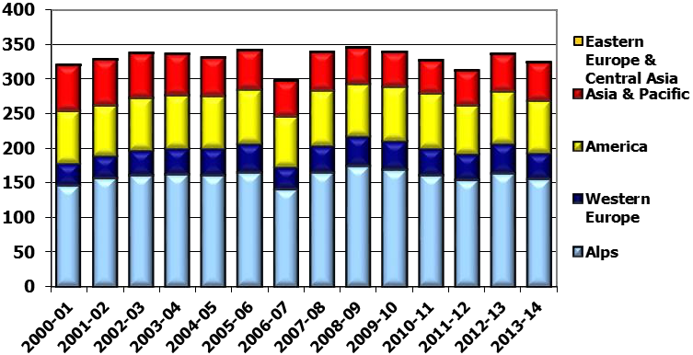
Evolution of skier visits per region
Source: Vanat, 2015, p. 14

Slide 9
Global travel and tourism sales by category 2013
Source: Adapted from Euromonitor International, 2014

Slide 10
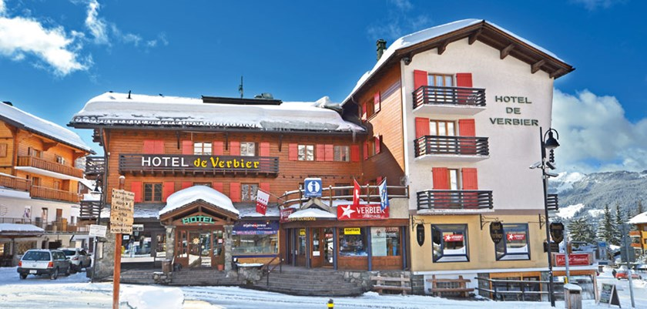
Profile
Patrick Bruchez: Alpine authenticity at the Hotel de Verbier
A quintessential, authentic Alpine hotel
  Royal chalet girl, celebrated hotelier, all-night partying
  Mature, affluent crowd; trendy mix of ski bums, jetsetters, regular holidaymakers and entrepreneurs
Trends
  faster pace operations: last minute booking
  customer turnover -fewer returnees
  technological changes

Slide 11
Winter sport tourism today
A trend towards stagnation in attendance
Undergoing consolidation
Vulnerable
  Spending patterns
  Climate change
Predictions:
  stable growth, future growth potential market

Slide 12
Average skier visits over the last 10 years in Europe and North America on a 100 base for season 2004/05
Source: Vanat, 2015, p. 10

Slide 13
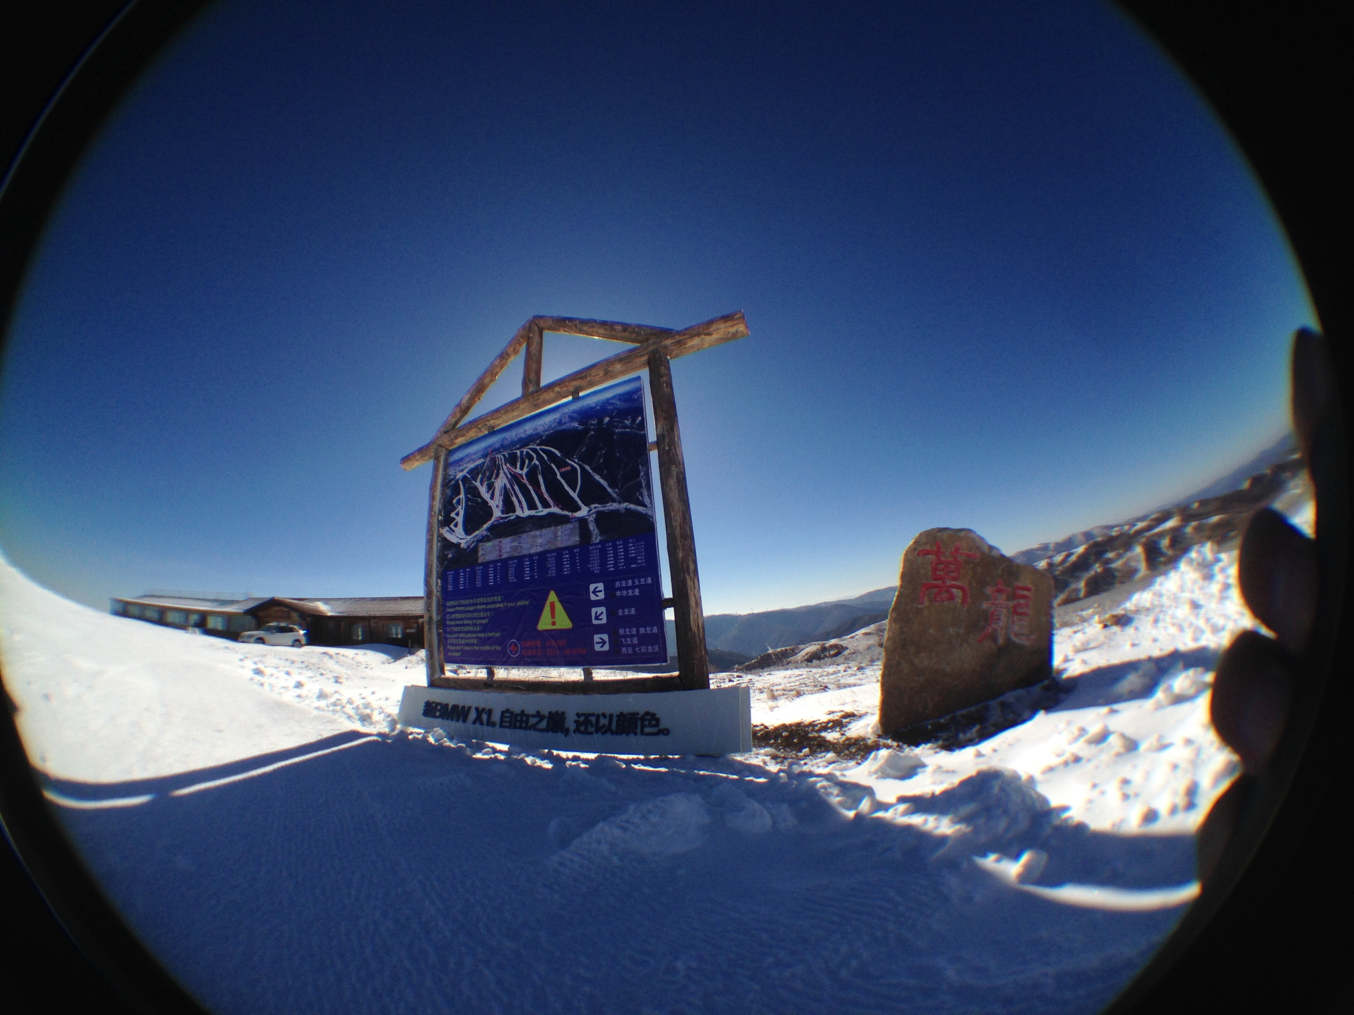
Case study
Winter sports: Part of the ‘China Dream’
Beijing 2022 Winter Olympics
  Chongli &Genting Resort
  Other country benefiting from China winter sports
    Beginner trails, private lessons, retail outlets
    Ski participation rise

Slide 14
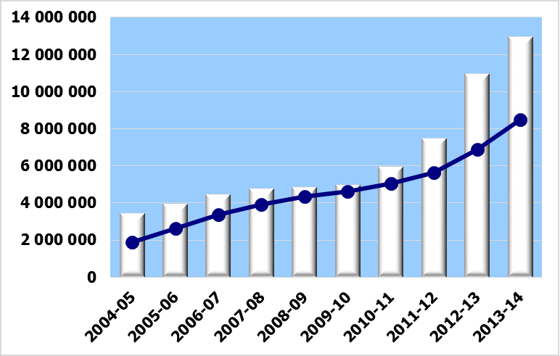
Evolution of skier visits in China
Source: Vanat, 2015, p. 124

